Slide 1


Slide 2





Welcome
for
Presentation
Sumit
Pradip
Saddam
Avik
Anku
Animesh
Shambu
Piyali
Riya

Slide 3



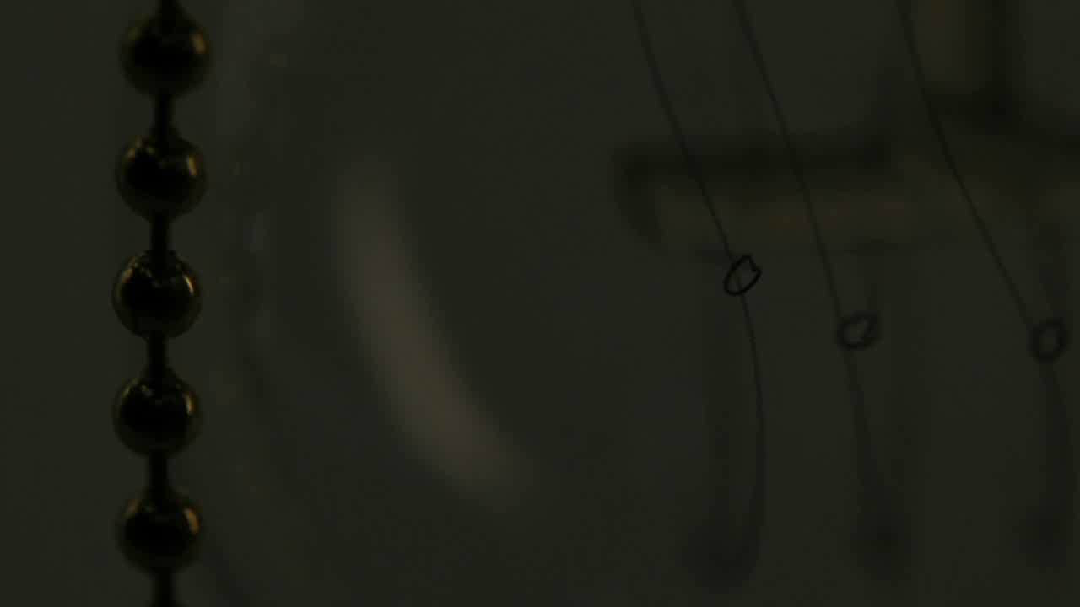
SaveMore Bank

Slide 4
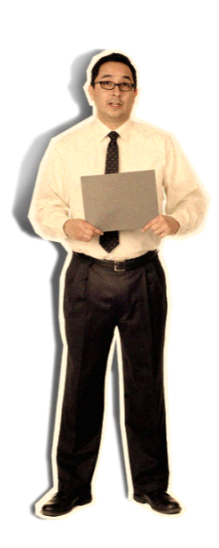


Bimal
Kislay

Slide 5






















































Where is Satyajeet ?
I don’t know.
Presented
By
Bimal
KISLAY KUMAR SINGH
BIMALENDU SINHA
&
SATYAJEET GOUR
Kislay

Slide 6
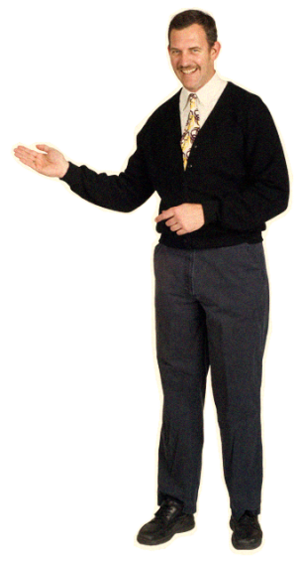
CONTENTS
Problem Statement
Solution – Mobile Banking
Why Mobile Banking ?
Why Mobile Apps ?
SaveMore App Demo
Satyajeet

Slide 7
SaveMore
?
?
Problem Statement

Slide 8
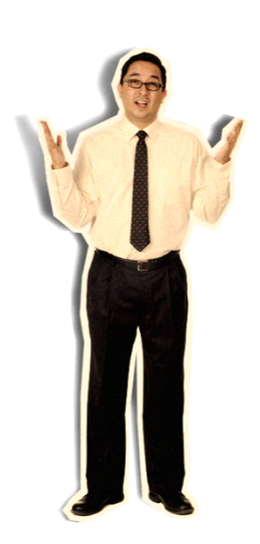
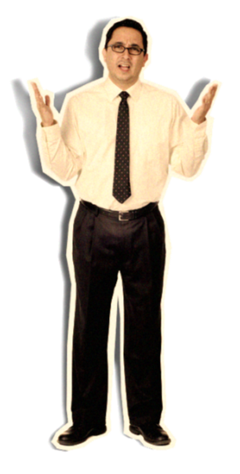
Problem Statement
SaveMore Bank has been established seventy years ago and has spread across the world. The activities have also increased in terms of the services offered and the volumes of transaction.
Problem ?
Problems in current system :-
Difficult to access accounts while traveling
Transfer of funds from one account to another is problematic
Difficult to manage needs of large number of customers

Slide 9

Solution
SaveMore
?
Mobile Banking

Slide 10

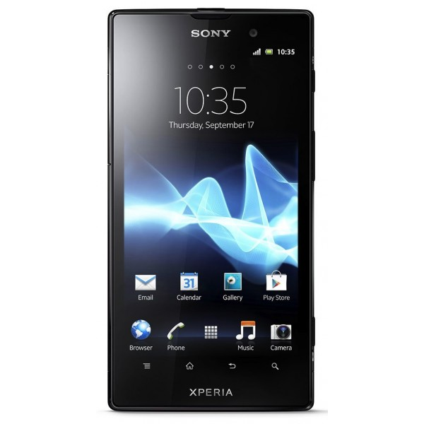
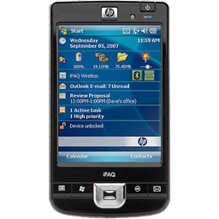
Mobile Banking
Mobile banking is a term used for performing balance checks, account transactions, payments, credit applications and other banking transactions through a mobile device such as a mobile phone or Personal Digital Assistant (PDA).

Slide 11
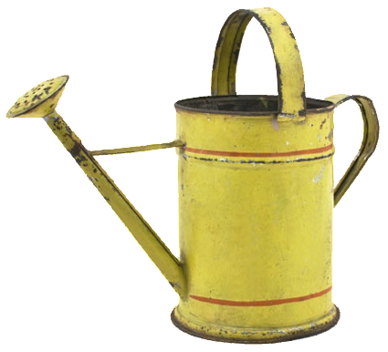

Notes:
…and propel

Slide 12














Why
Mobile
Banking
.
Notes:
…global causes.

Slide 13



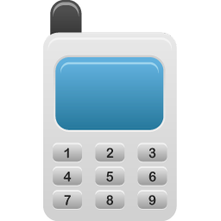






A’s
Any Time
3
Any Where
Any Device
Notes:
Along the way we’ve discovered…

Slide 14





Options of Mobile Banking
Mobisites
SMS
USSD
But we don’t need these
Notes:
Mobile Banking can be provided by Mobisites, USSD or SMS services but the real power lies in apps.

Slide 15
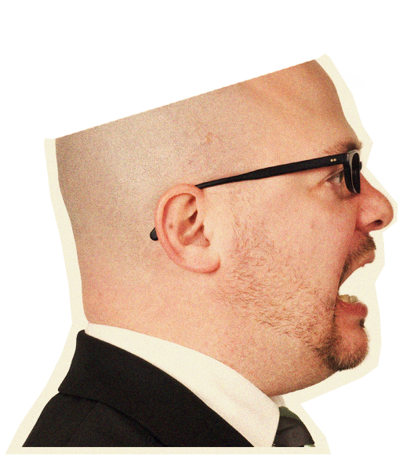
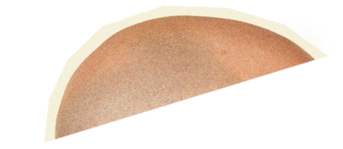



No Brainer
POWER
Real
lies
in
APPS
Flexible
Reliable
User Friendly
are
because
.
.
.

Slide 16









SaveMore Bank Mobile App supports all
Platforms
&
Handsets
Notes:
Our banking app is supported in all mobile devices from lowest budget Nokia to mightiest Android, Blackberry or iphone.

Slide 17
so with SaveMore Bank App
its like having a
SaveMore Bank Branch
right in your pocket…

Slide 18
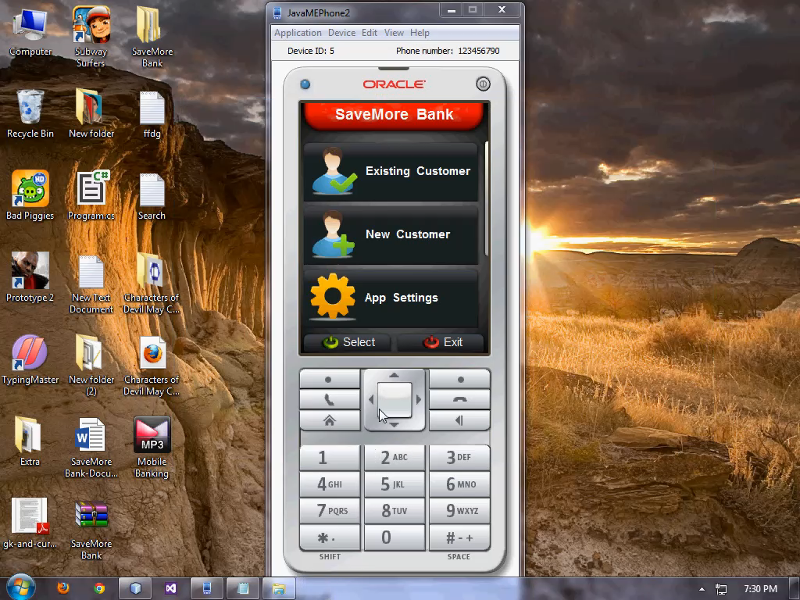
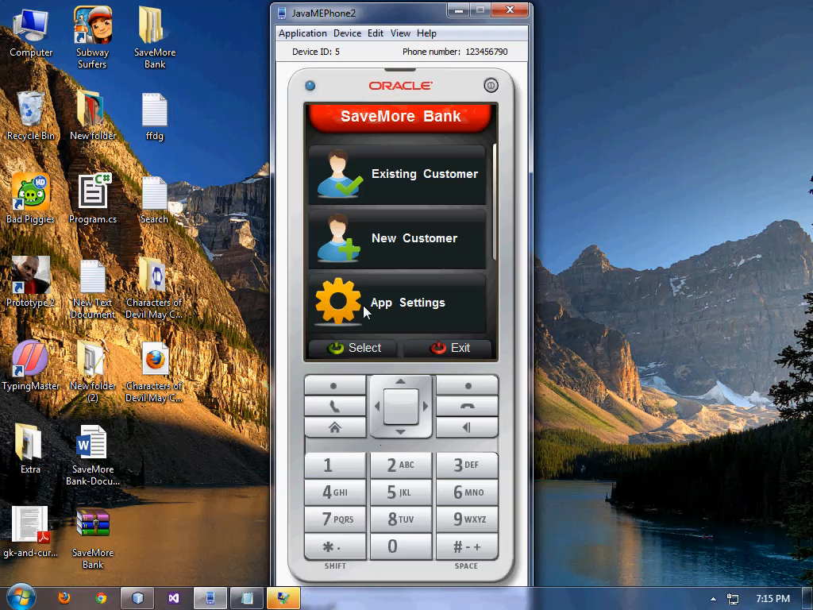
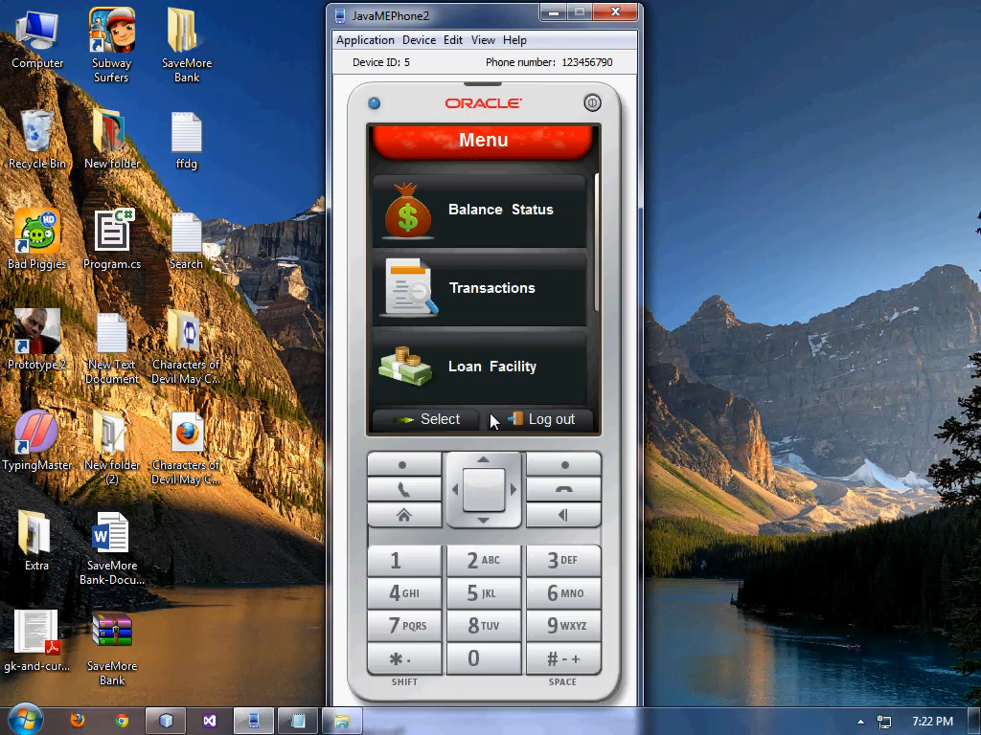
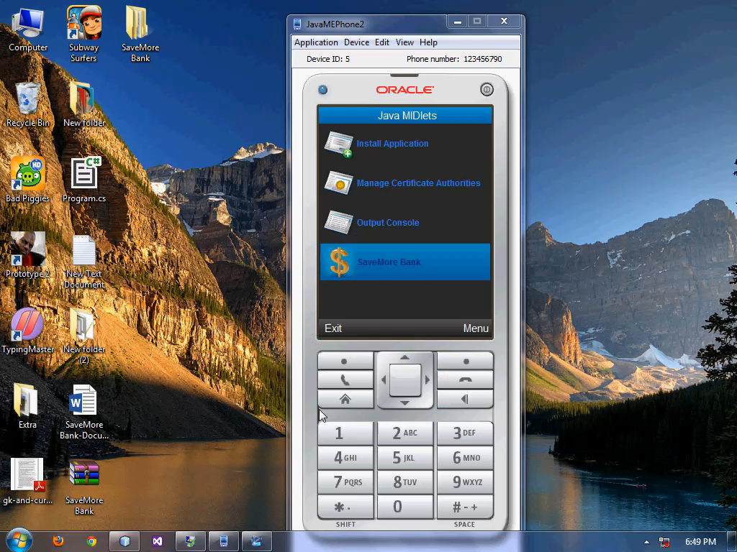
Features
Apply for Loan
Customize App
View Account Info
Creating Account
Create Account
View Account Info
Balance Status
Loan Info
Apply for Loan
Loan Application
Loan Status
Customize App
Themes
Transactions
SaveMore Bank
App Demo

Slide 19

Thank You

Slide 20











now what are you looking at ?
Start Loving it…
now that’s more
like it…
Sumit
Pradip
Saddam
Avik
Anku
Animesh
Shambu
Piyali
Riya

